Slide 1

Team 9
Wu Jiangtao
Cao Jiahao
Zheng Yi

Slide 2
APP Over ODL
Display Physical Topology
Calculate the shortest path between two nodes
Add, delete, search and display static routes in specific router

Slide 3
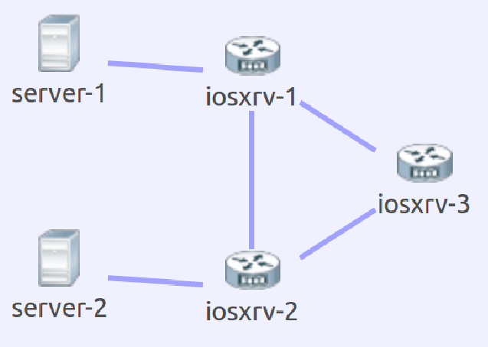
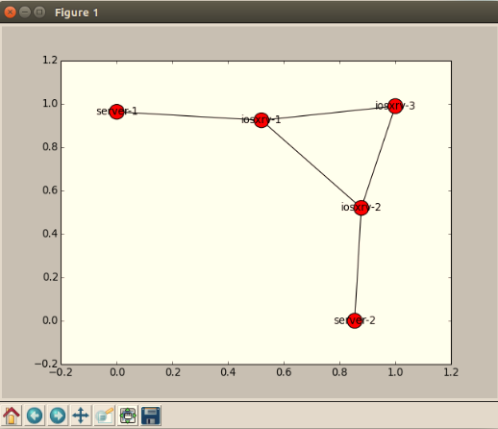
Display Physical Topology
Topology in VM Maestro
Topology display
EXTERNAL LIB:
NETWORKX
MATPLOT LIB
TKINTER

Slide 4
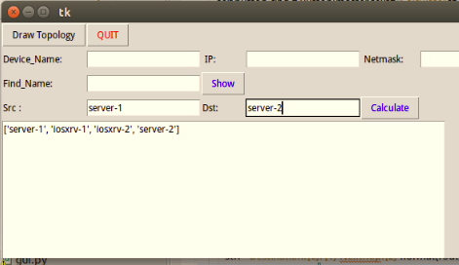
Calculate the shortest path between two nodes
Physical topology
The shortest path between two servers

Slide 5
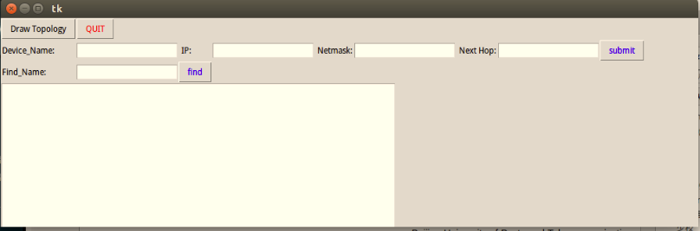
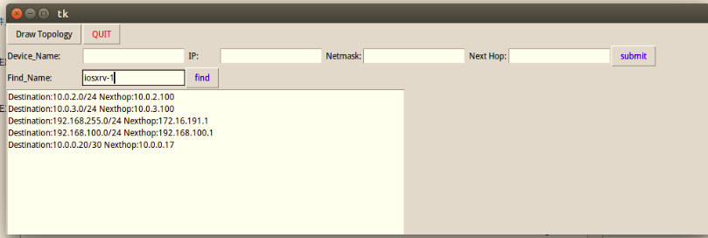
Add delete search and show static routes in specific router
The operation interface
The results of adding static routes

Slide 6
Further expansion
(1) By increasing the path parameters such as bandwidth and delay , we can calculate the optimal routing between two points.
(2) By increasing the flow QoS requirements, we can calculate the optimal flow map of the whole network.

Slide 7
Thank you!

